Slide 1

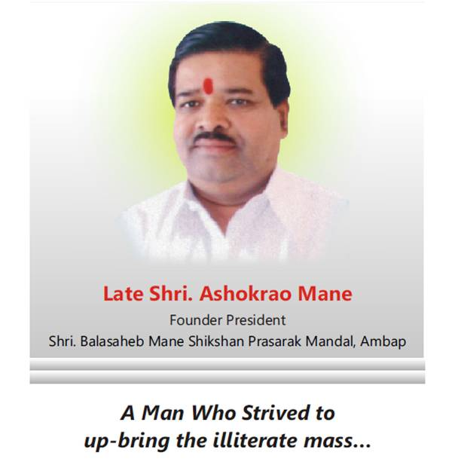
Shri Balasaheb Mane Shikshan Prasarak Mandal Ambap’s
Womens College of Pharmacy,
Peth-Vadgaon
Tal-Hatkanangle, Dist-Kolhapur.
Late Shri. Ashokrao Mane

Slide 2
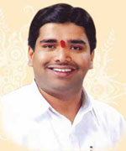
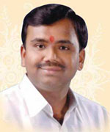
Hon. Shri. Vijaysinh Mane
President
Hon. Shri. Vikasrao Mane
Executive President

Slide 3
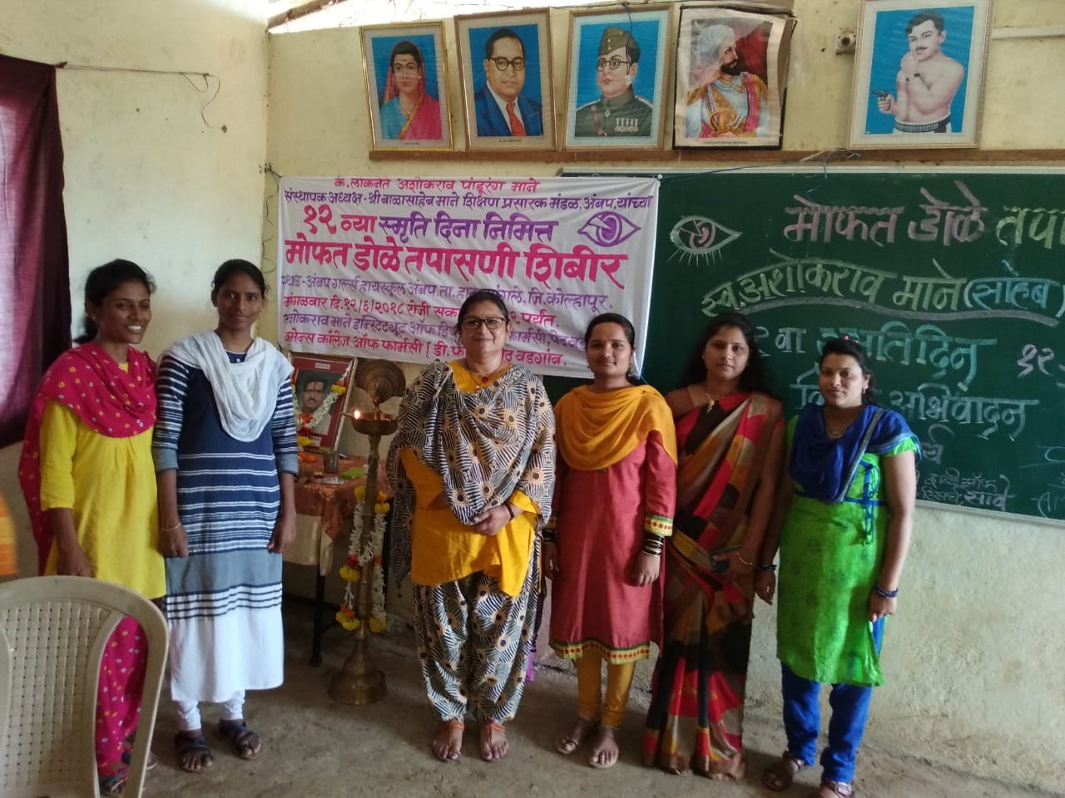
Eye checkup camp at Ambap on Date:12/06/2018

Slide 4
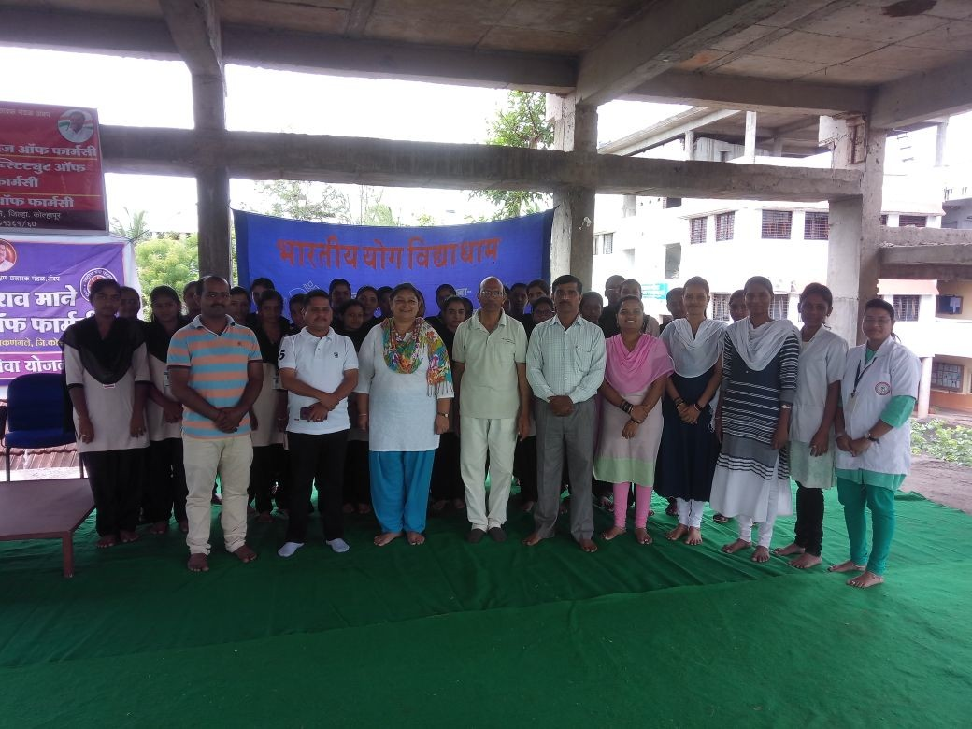
Celebration of International Yoga Day

Slide 5
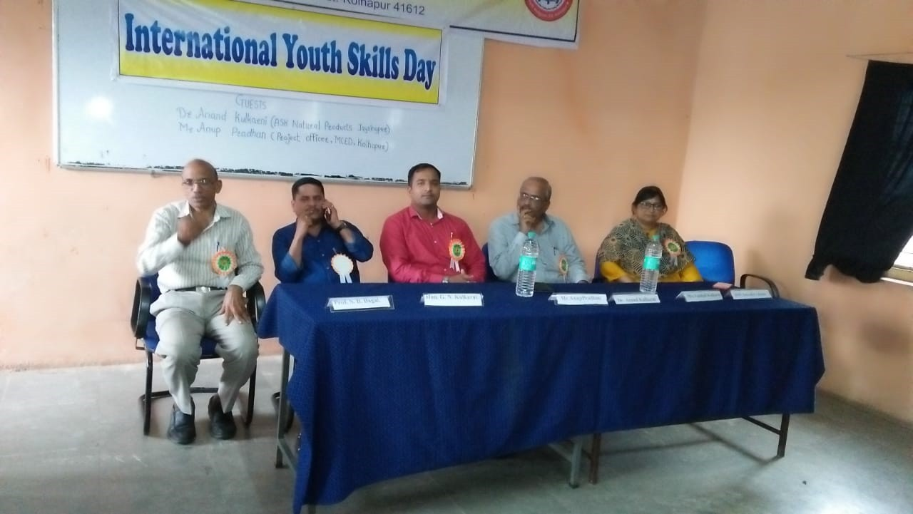
Celebration of
International Youth Skills Day on Date 20/06/2018

Slide 6
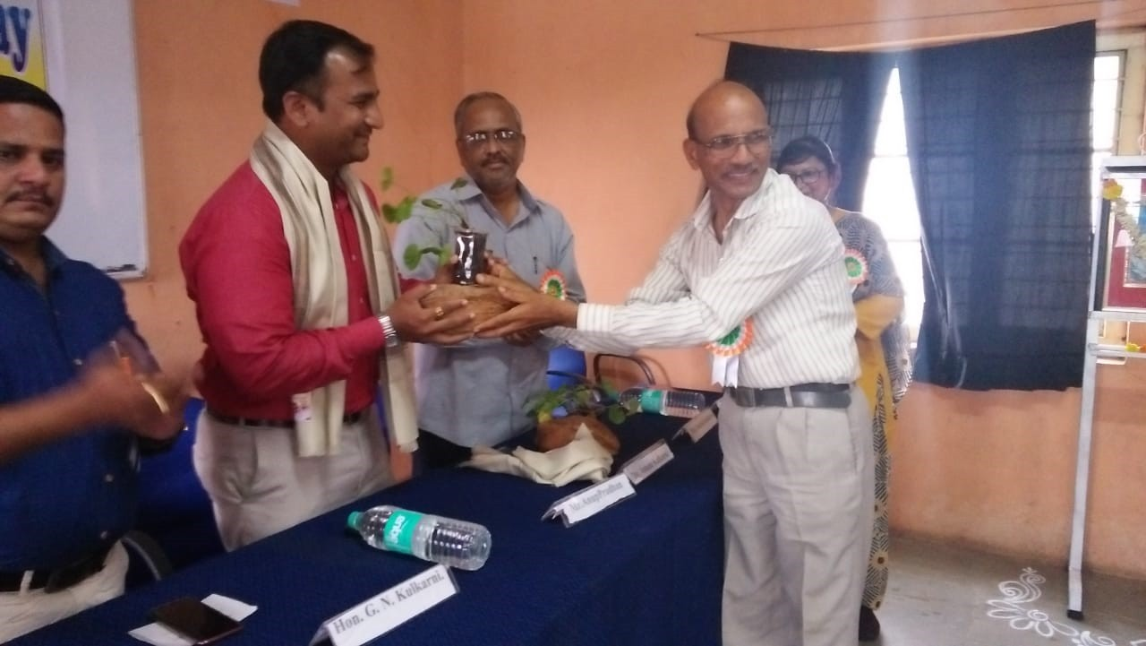

Slide 7
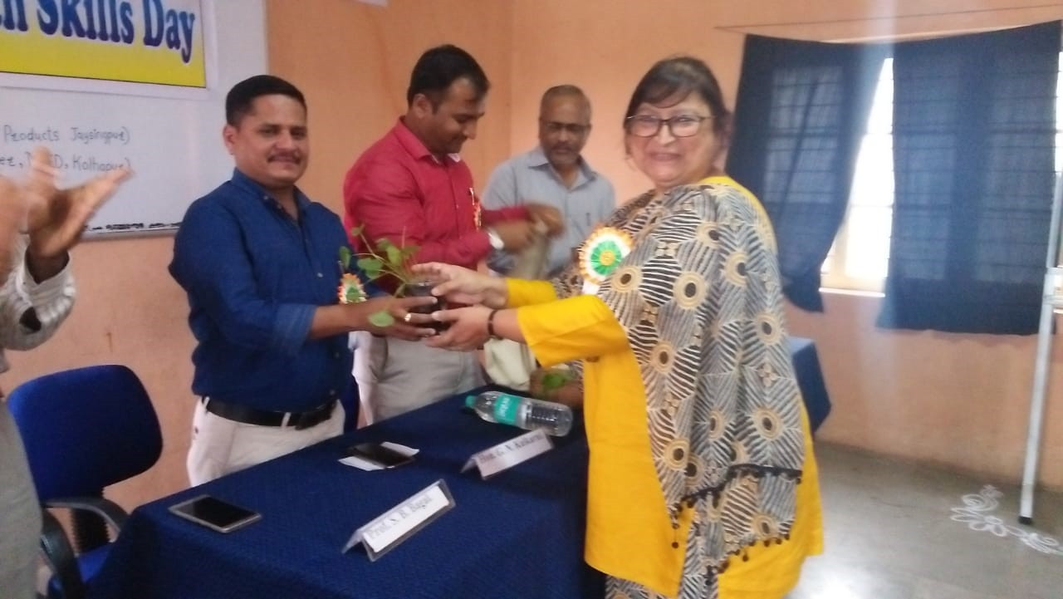

Slide 8
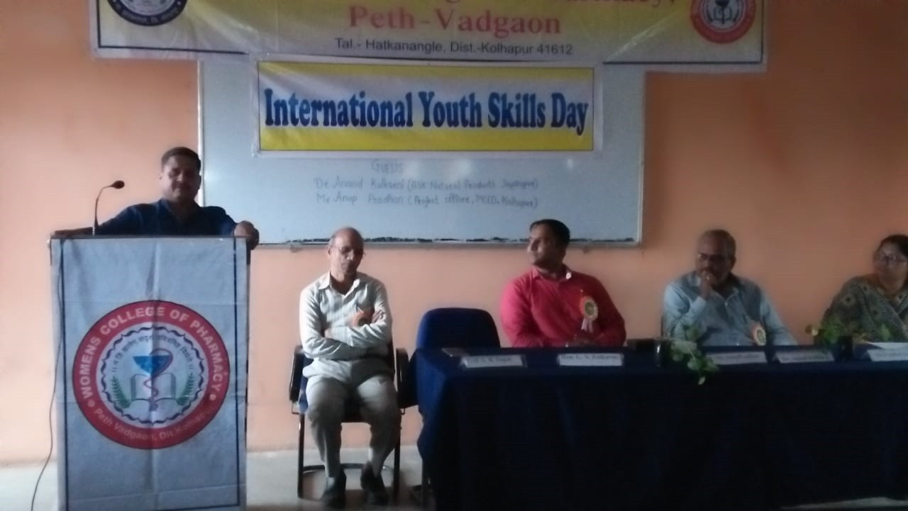

Slide 9
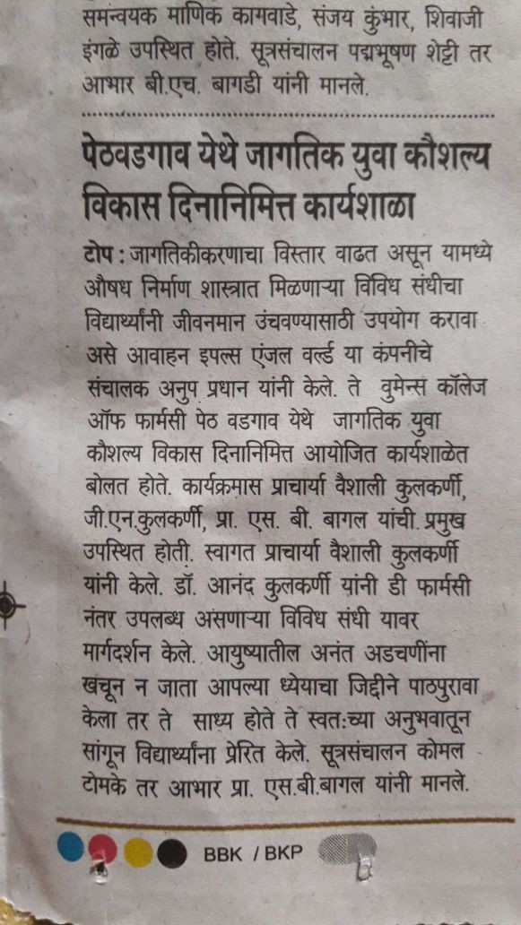
News of The College Regarding International Youth Skills Day Celebration

Slide 10
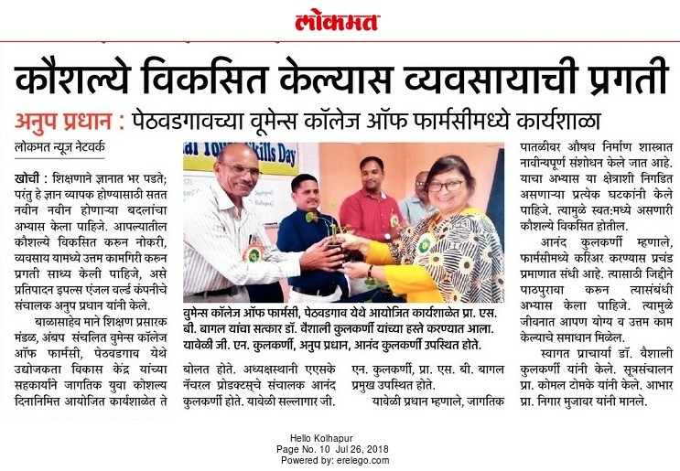

Slide 11
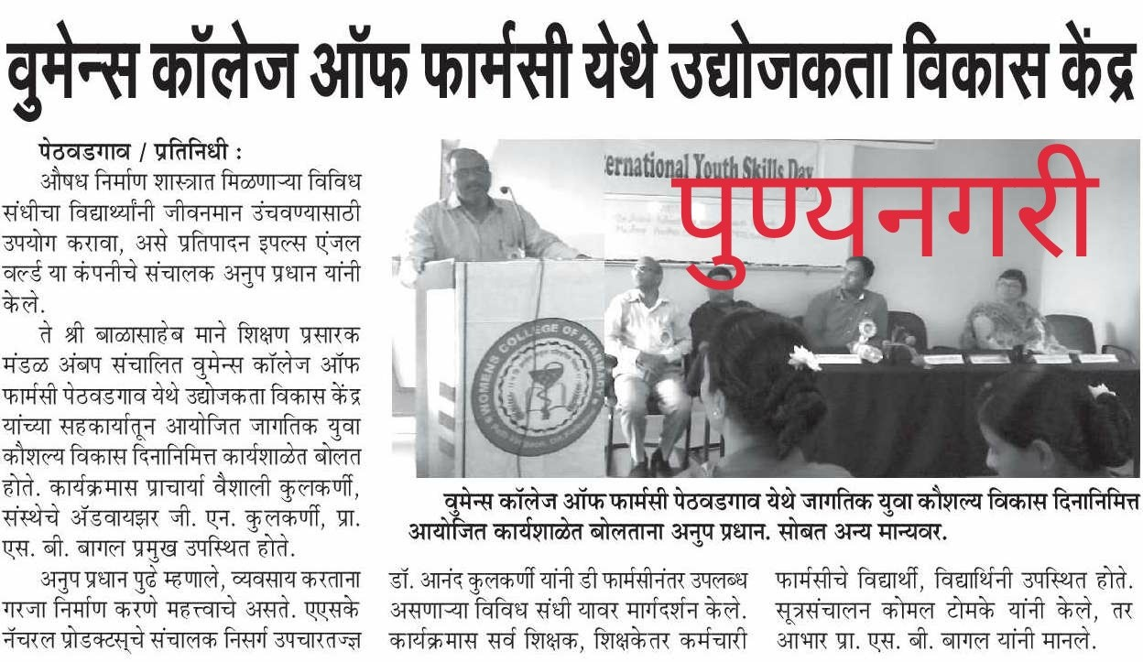

Slide 12
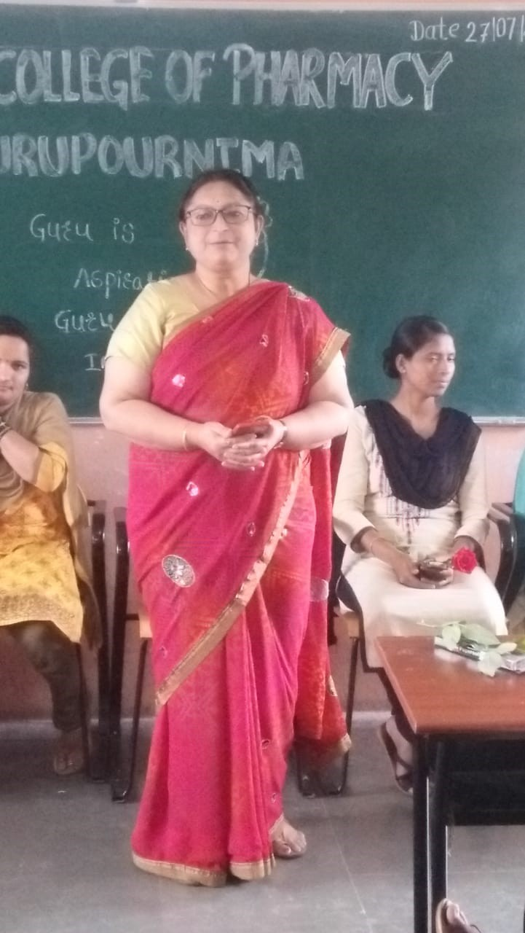
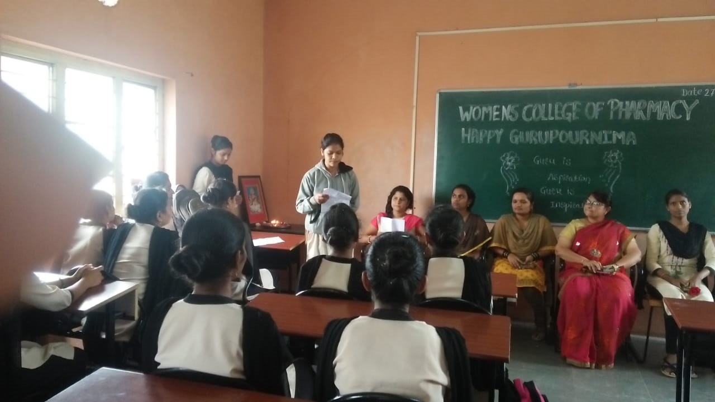
CELEBRATION OF GURUPOURNIMA
On Date:27/07/2018

Slide 13
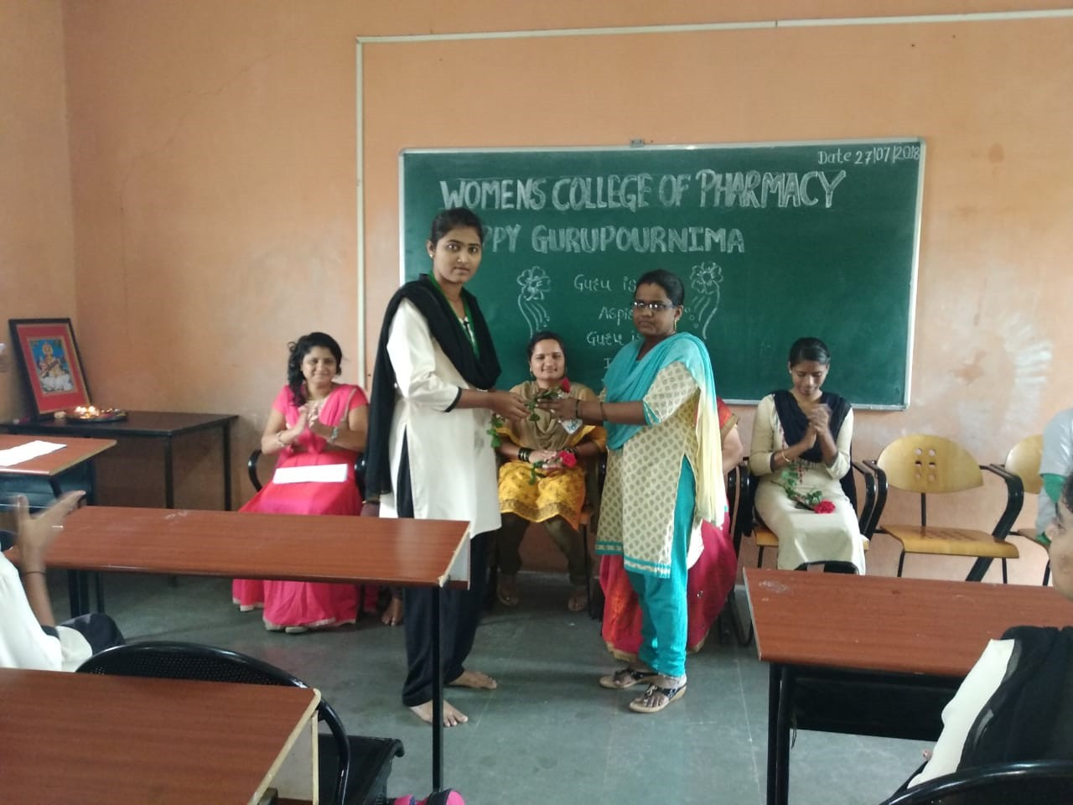
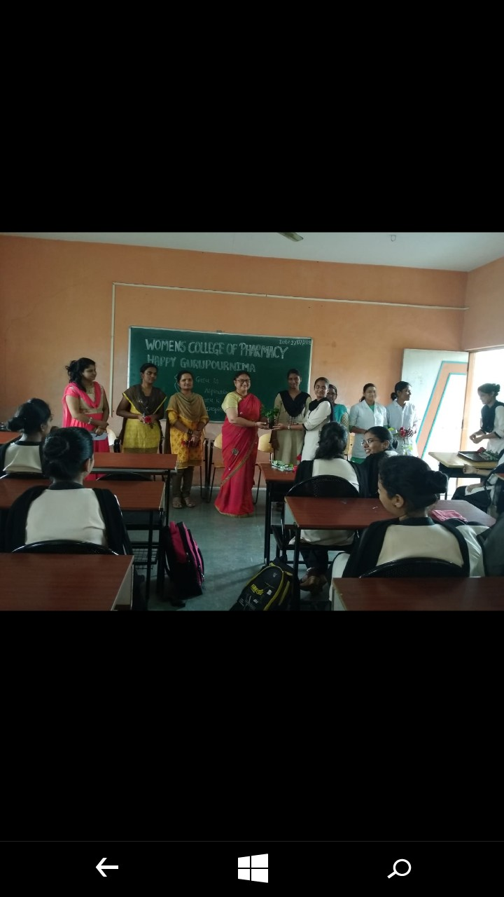

Slide 14
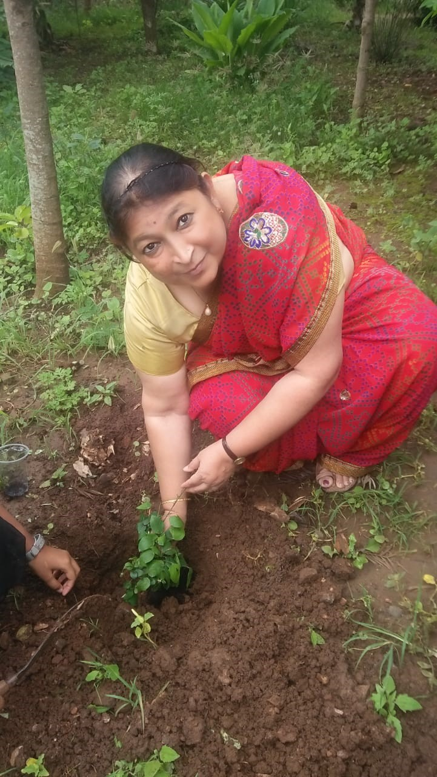
Tree Plantation on Occasion of Grupornima by Principal Madam

Slide 15
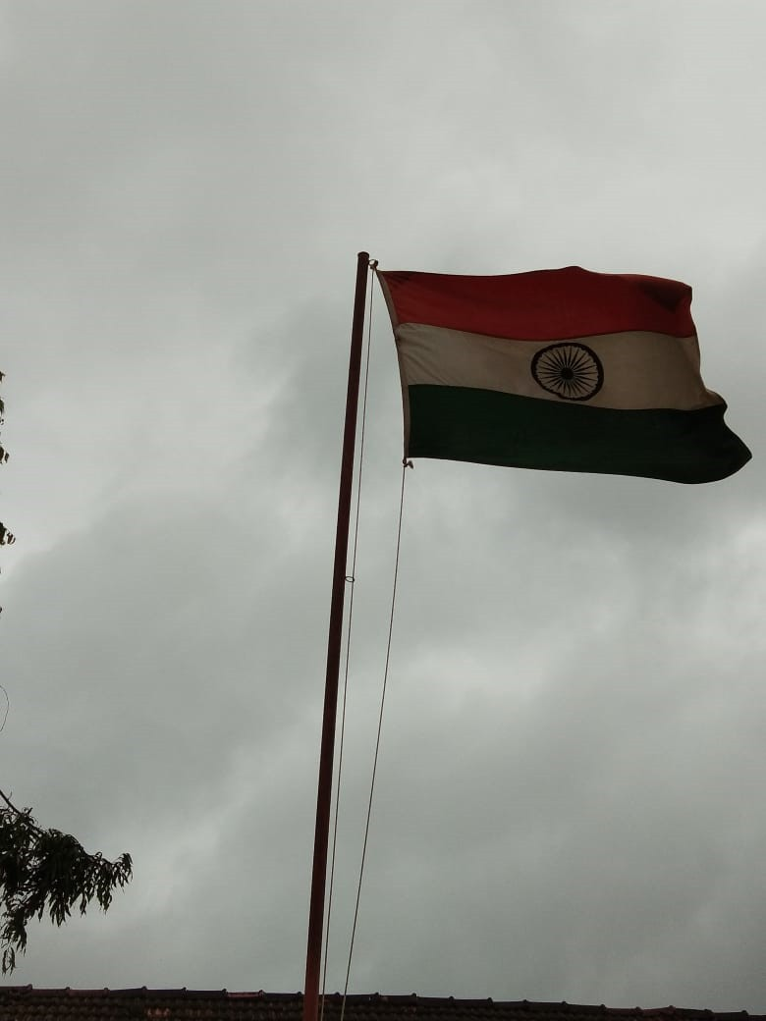
Celebration of Independence Day on Date :15/08/2018

Slide 16
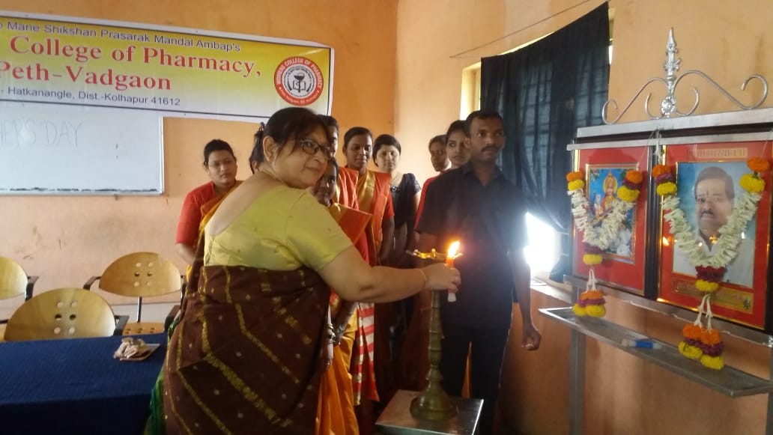
Celebration of Teachers Day On Date: 05/09/2018

Slide 17
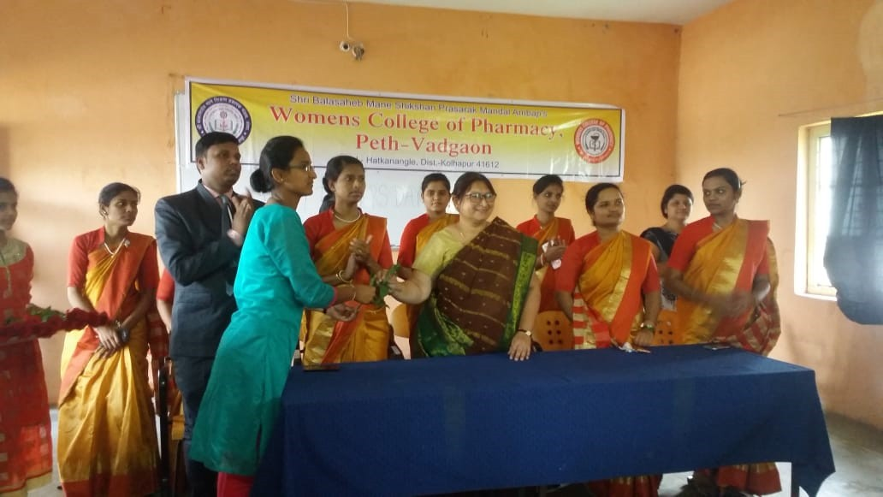

Slide 18
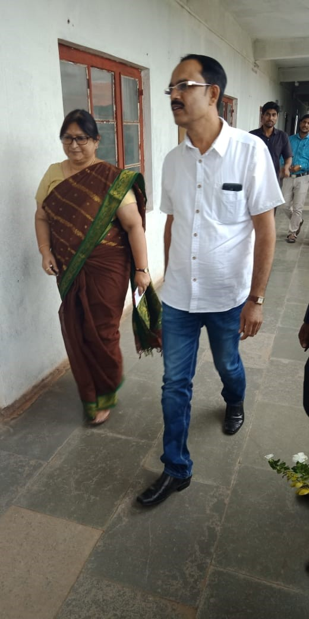
Induction Programme
On Date: 05/09/2018

Slide 19
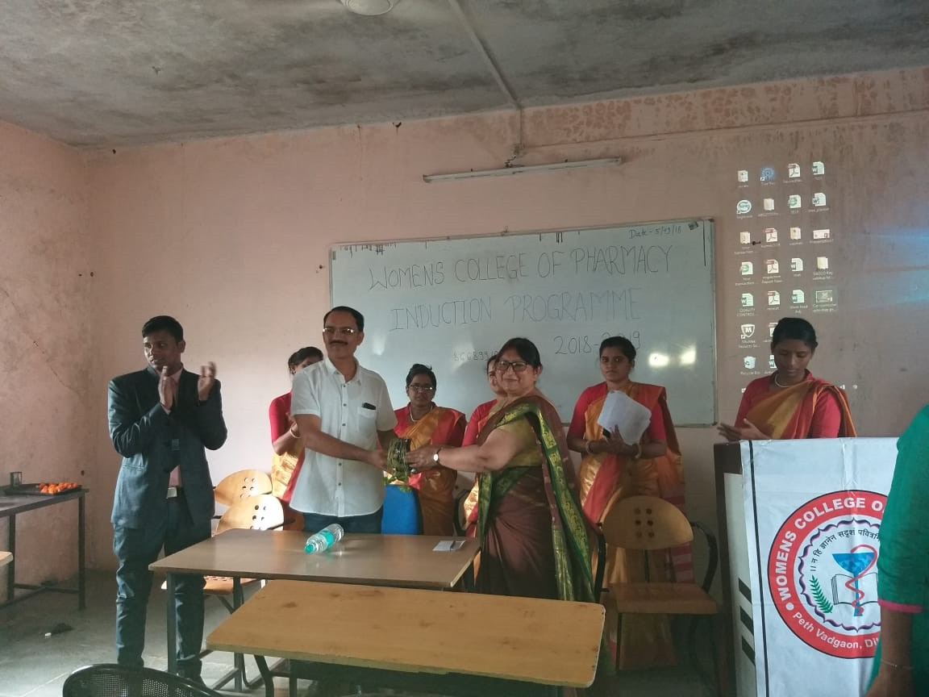

Slide 20
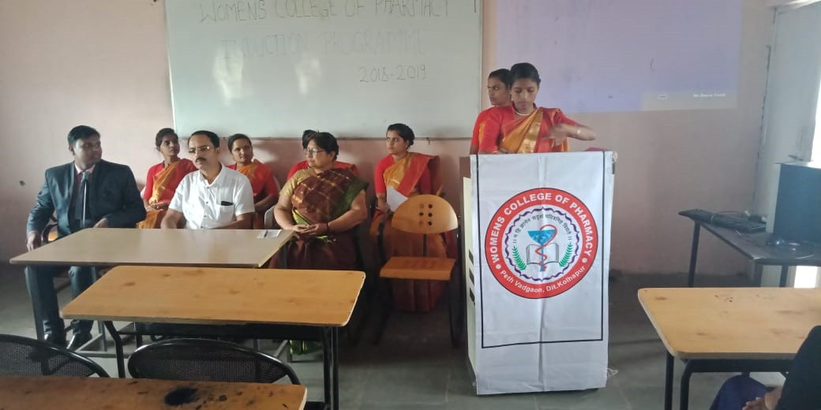

Slide 21
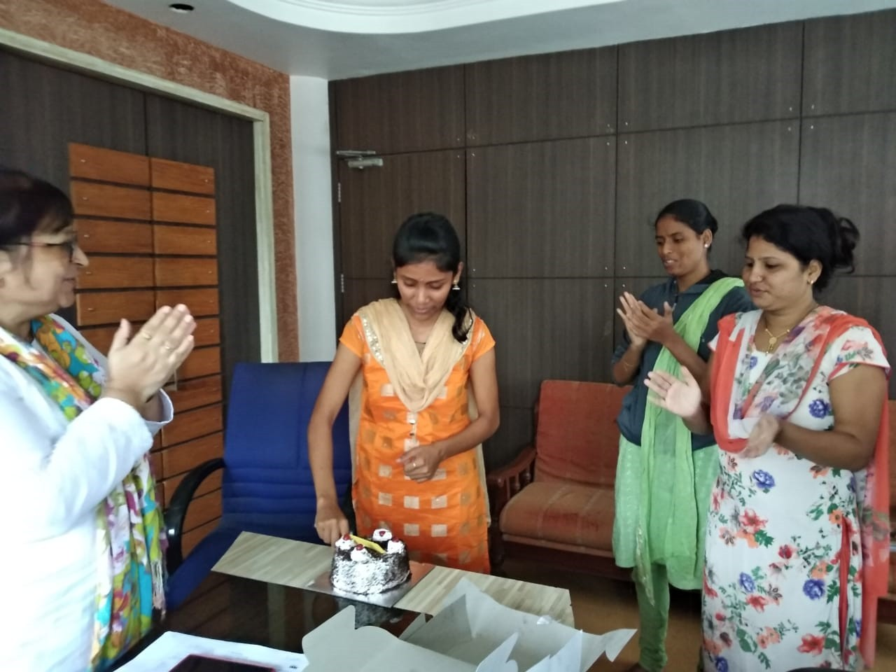
Celebration of Birthday of Staff

Slide 22
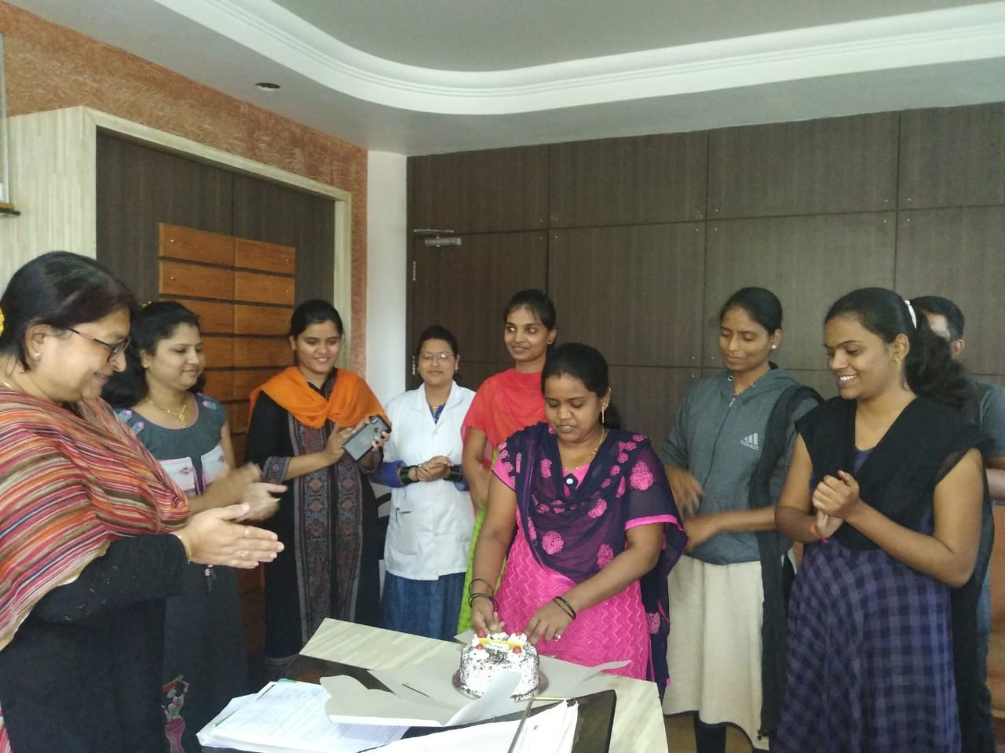

Slide 23
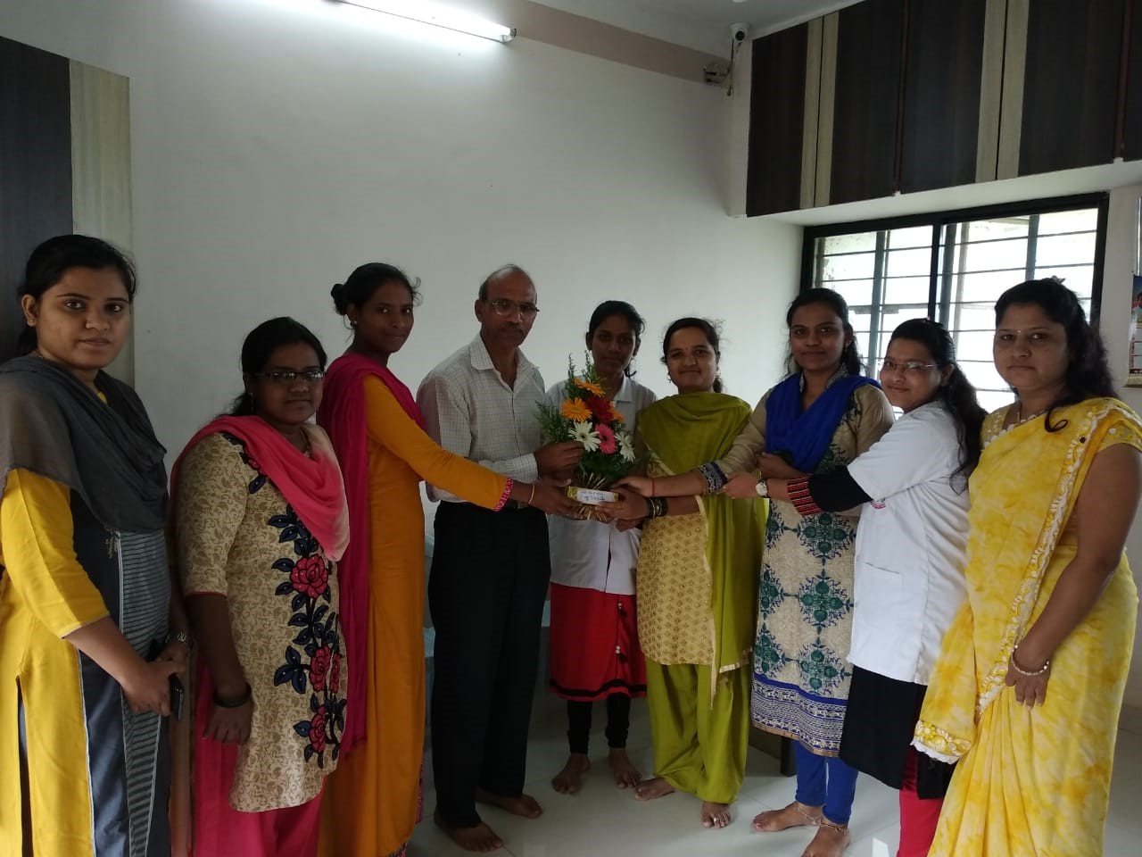
Celebration of Birthday of Senior Faculty

Slide 24
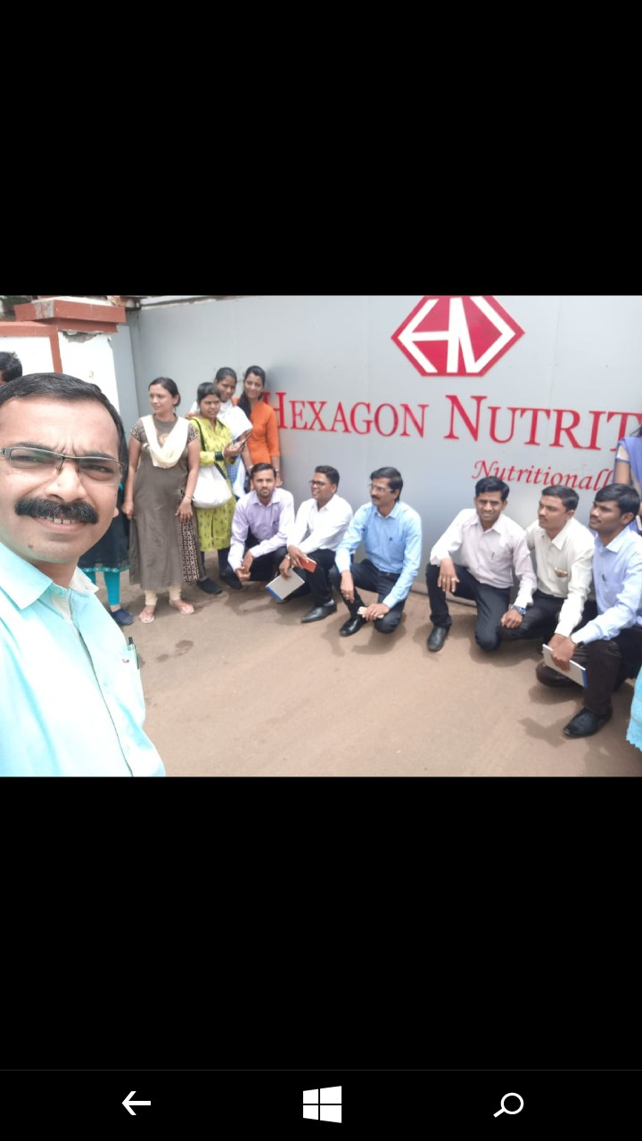
Continuous Up gradation of staff
Industrial Training at Nasik M/S-Neutralytica Research Pvt. Ltd. Nasik

Slide 25
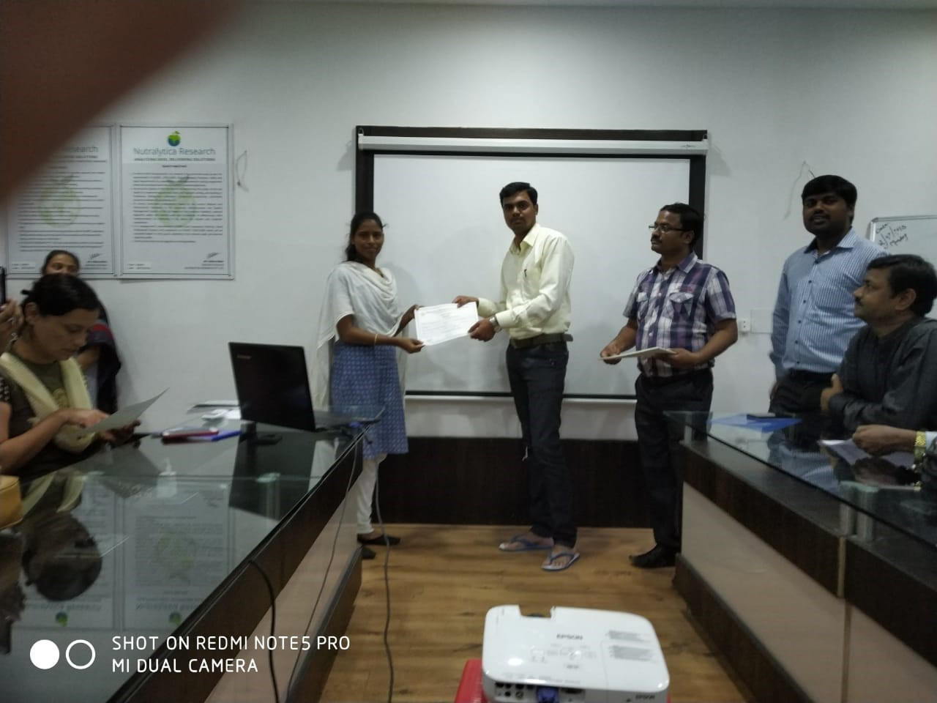

Slide 26
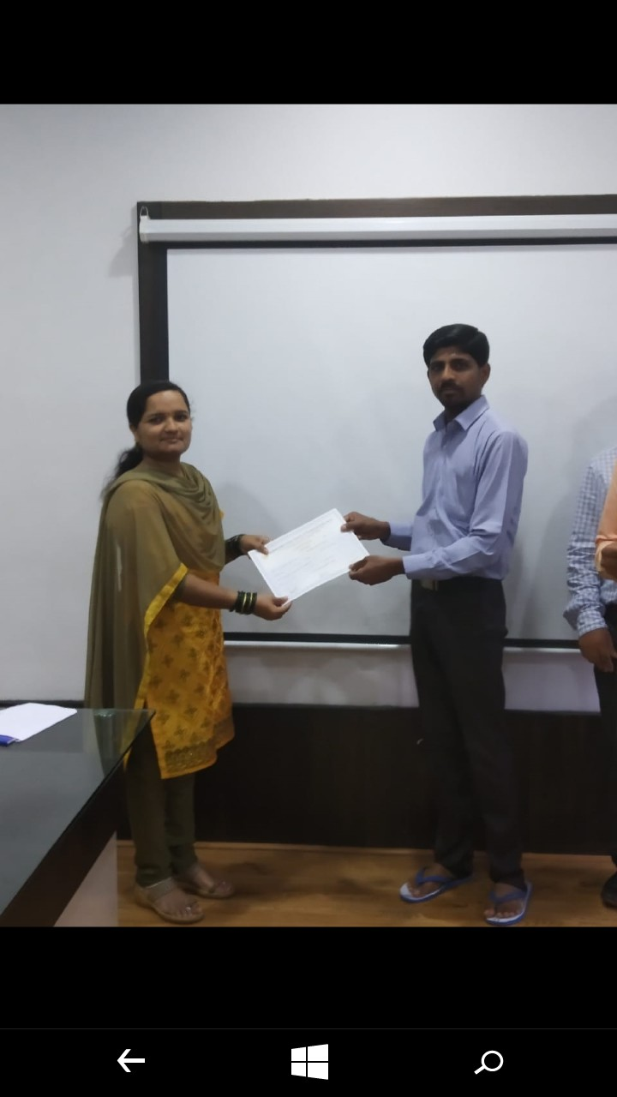

Slide 27
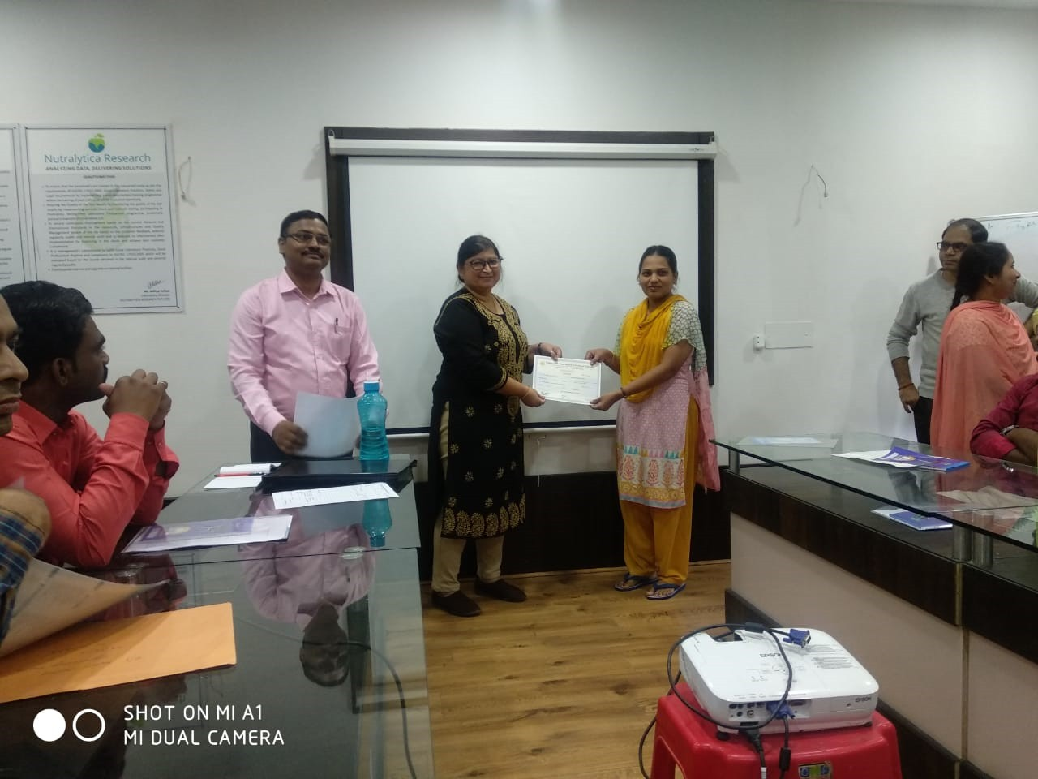

Slide 28
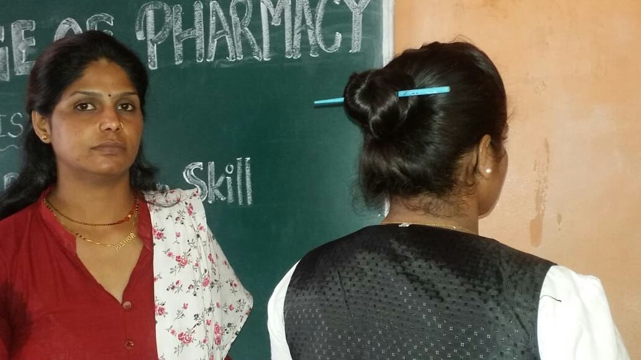
Personal Grooming of Womens Family On Date: 11/07/2018

Slide 29
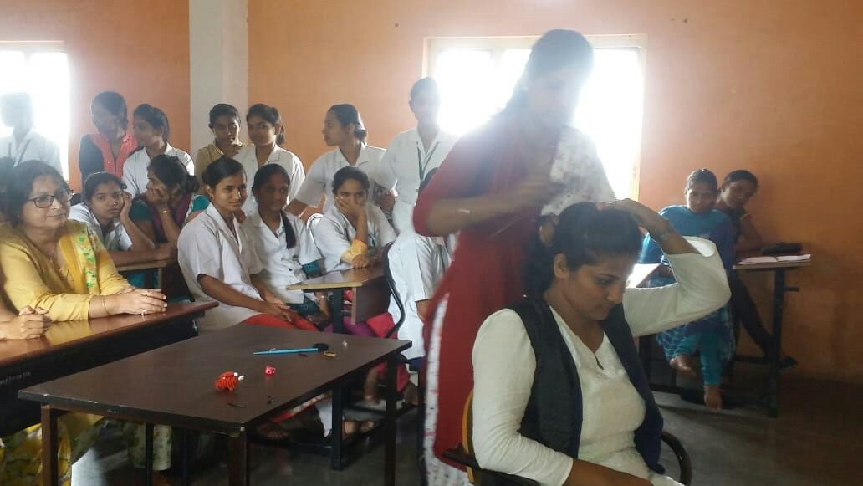

Slide 30
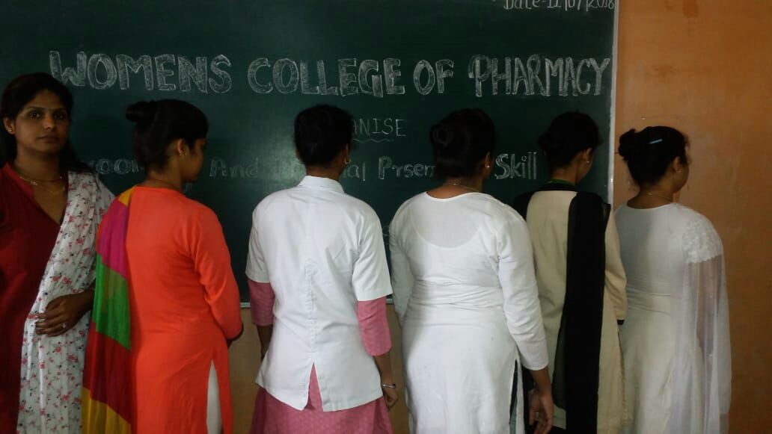

Slide 31
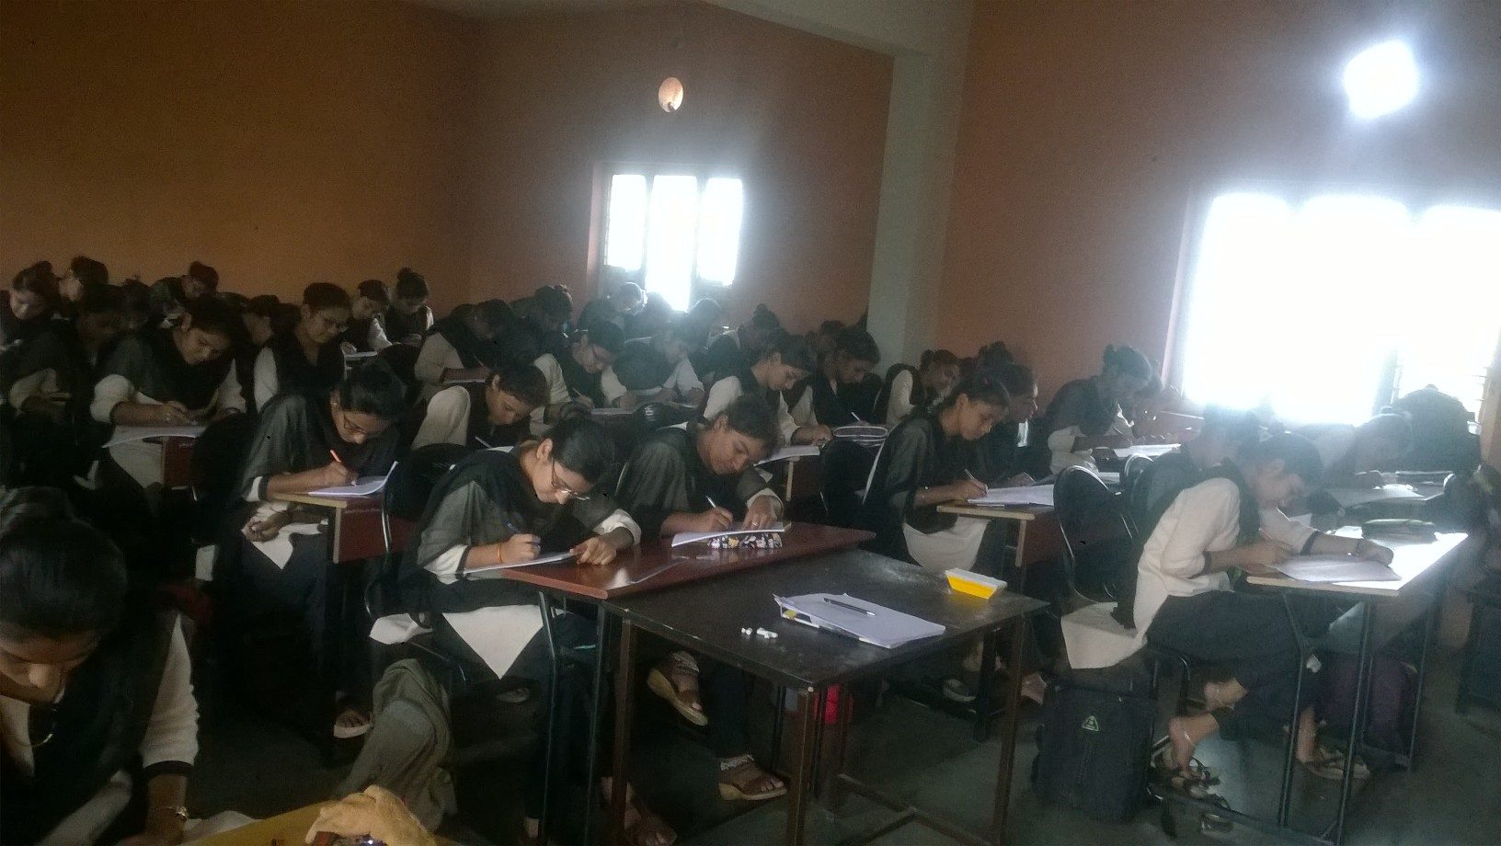
Class Test of Girls

Slide 32
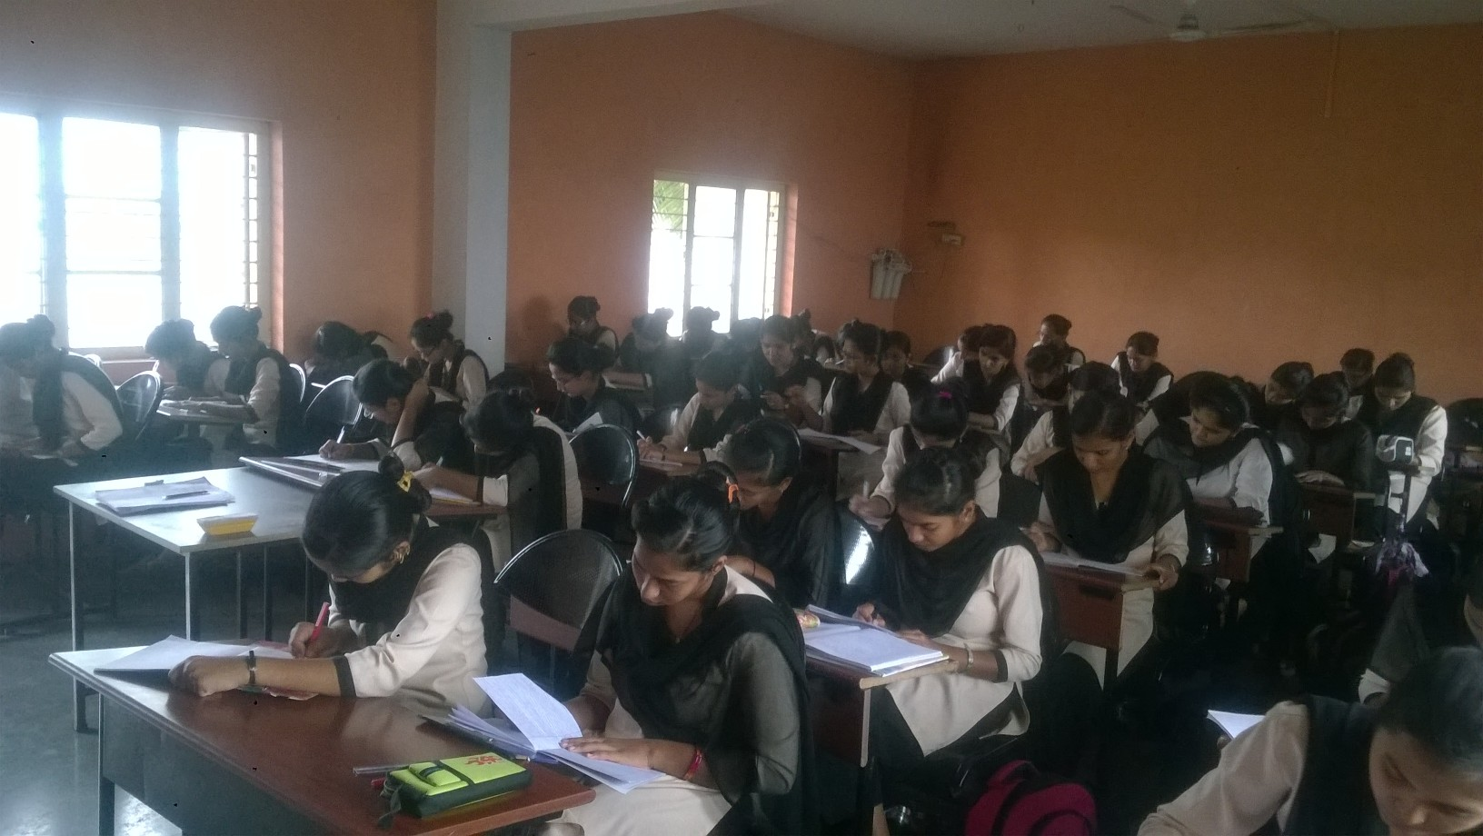

Slide 33
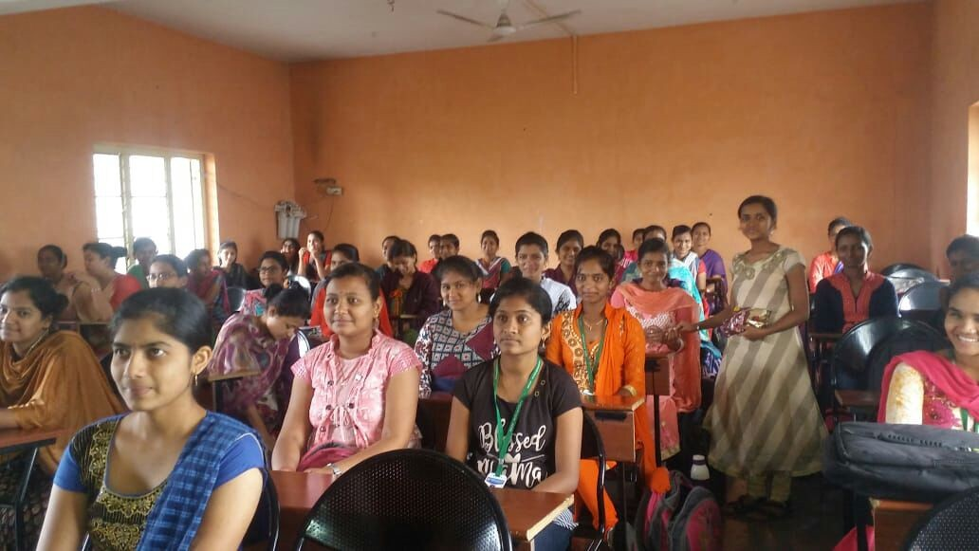
Birthday celebration of students

Slide 34
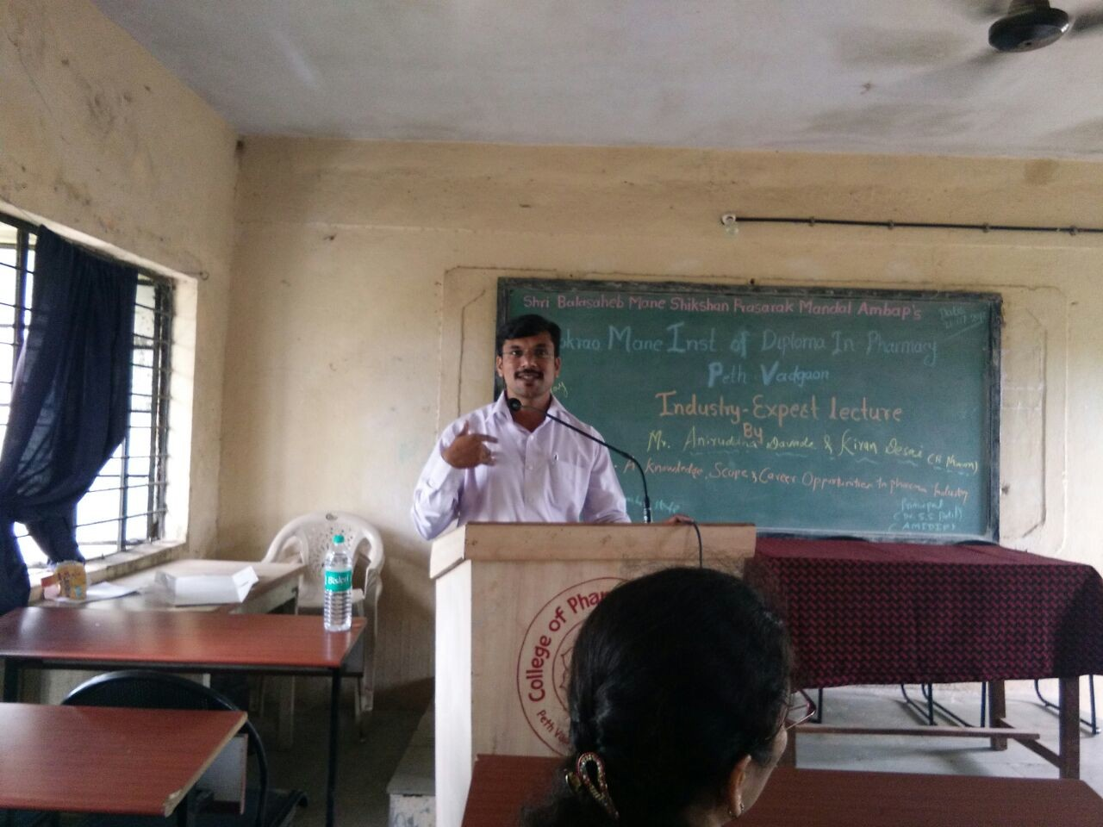
Industry Expert Lecture
On Date: 21/07/2018

Slide 35
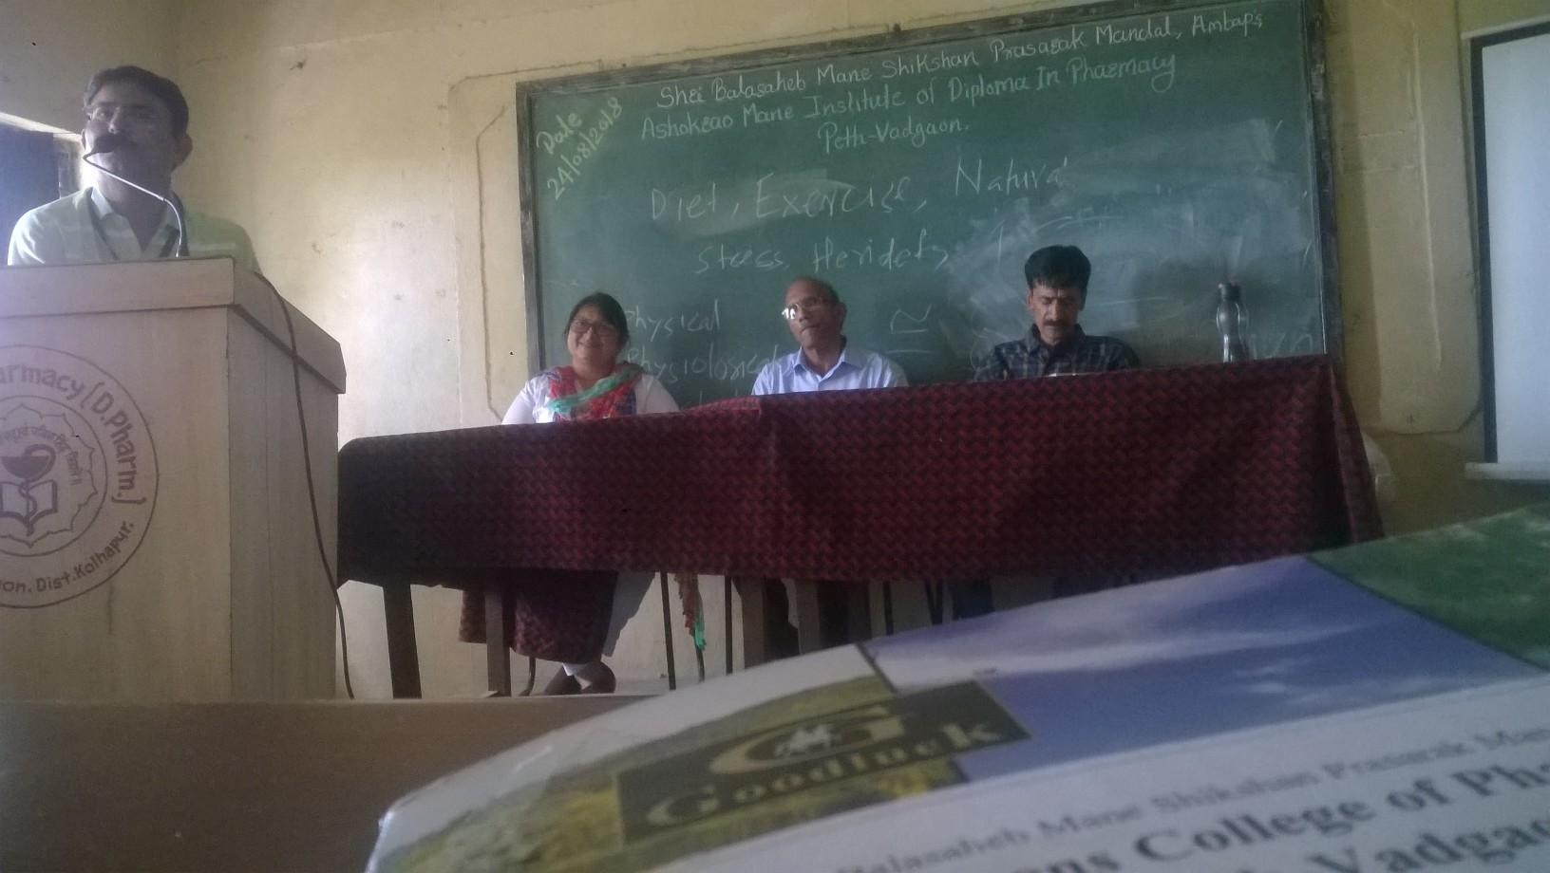
Fitness Lecture
On Date: 24/08/2018

Slide 36
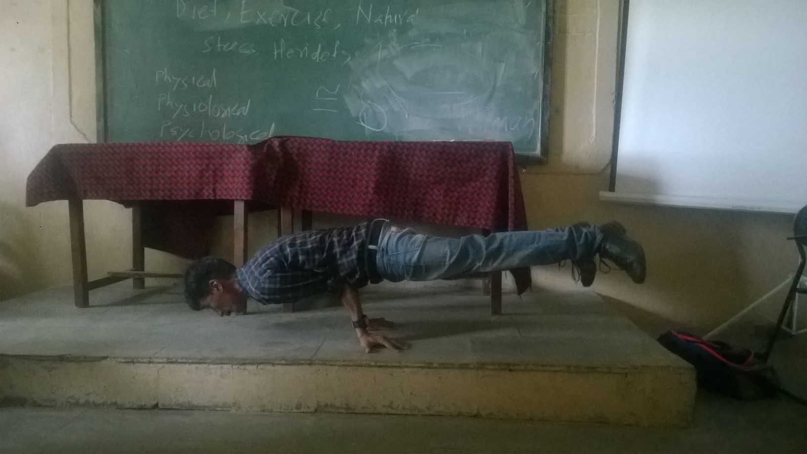

Slide 37
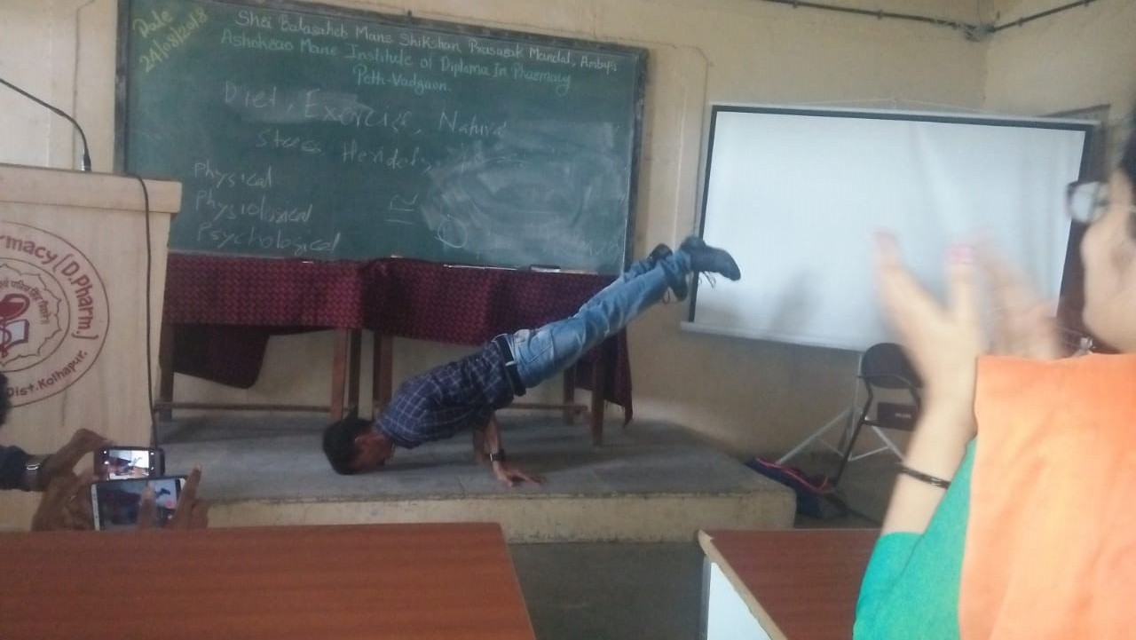

Slide 38
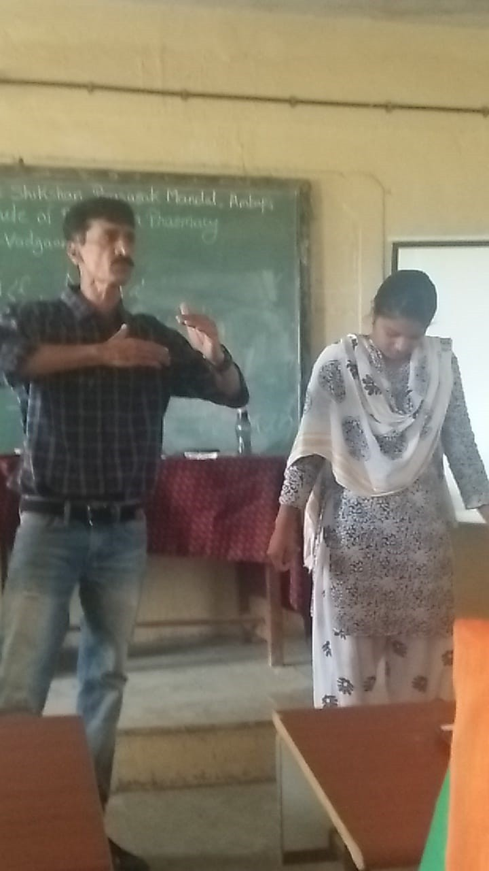

Slide 39
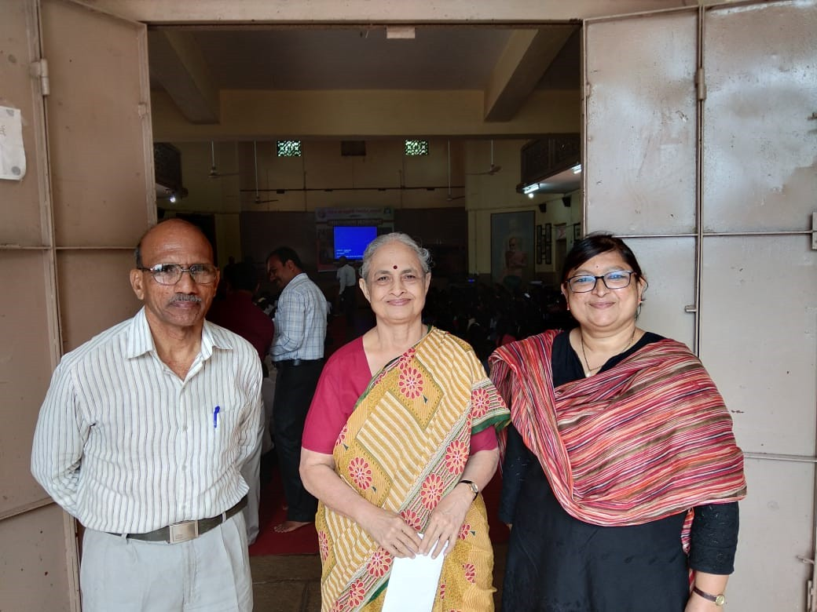
Courtesy Visit and Invitation to Rani Bang

Slide 40
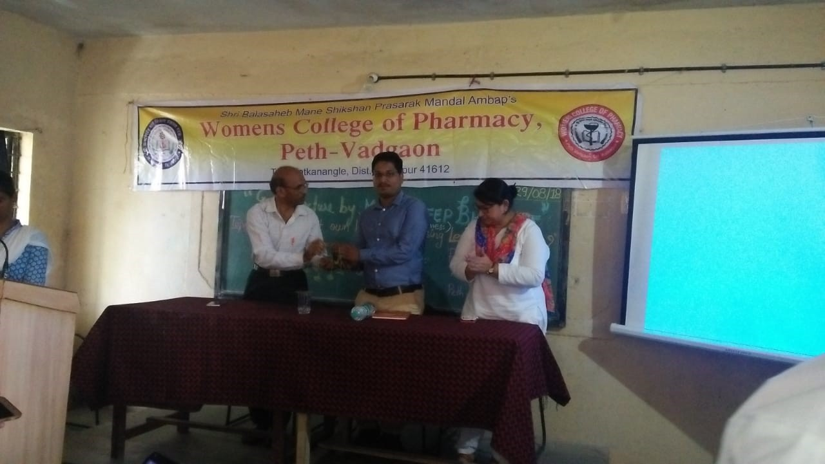
Entrepreneurship Lecture on How To Start Business by using Less Than 1000 rupees only …..? On Date: 29/08/2018

Slide 41
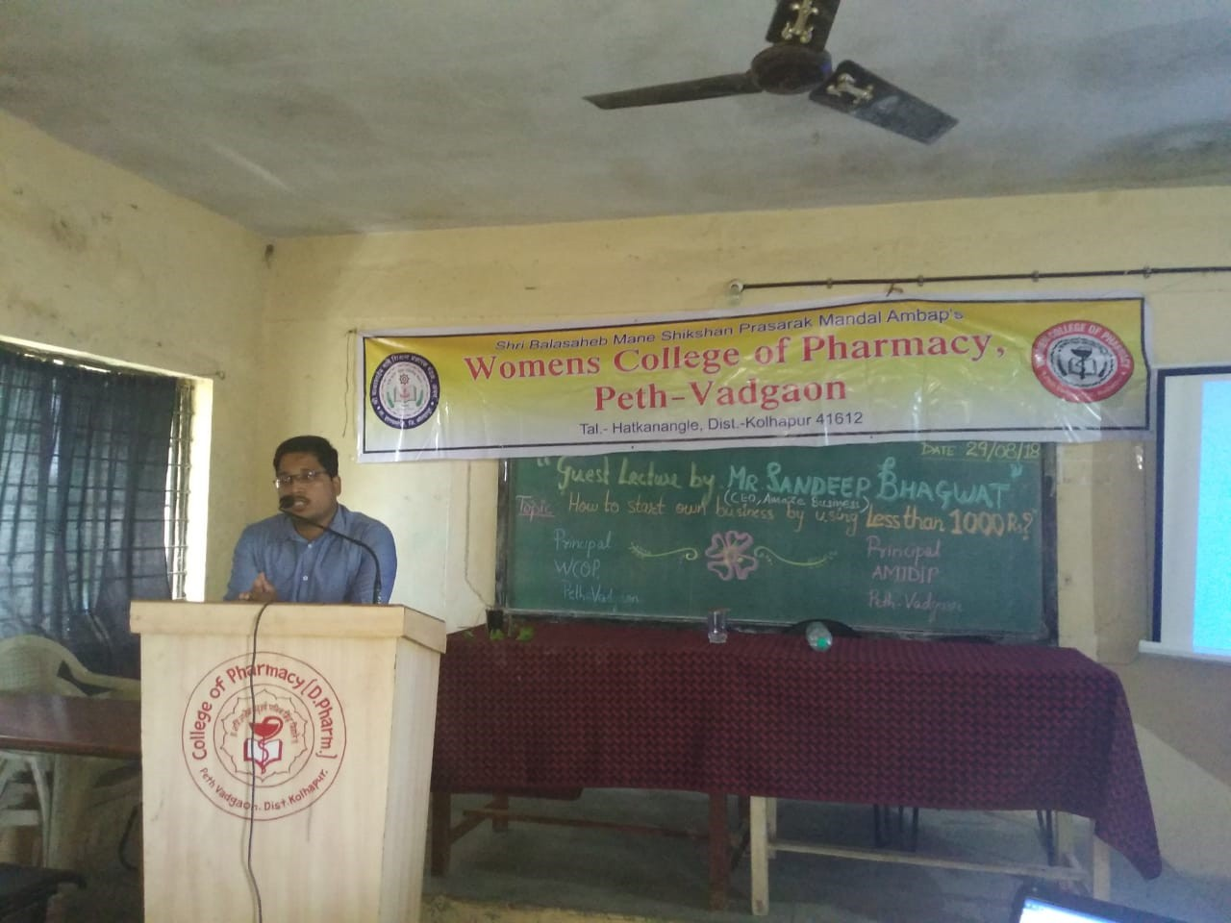

Slide 42
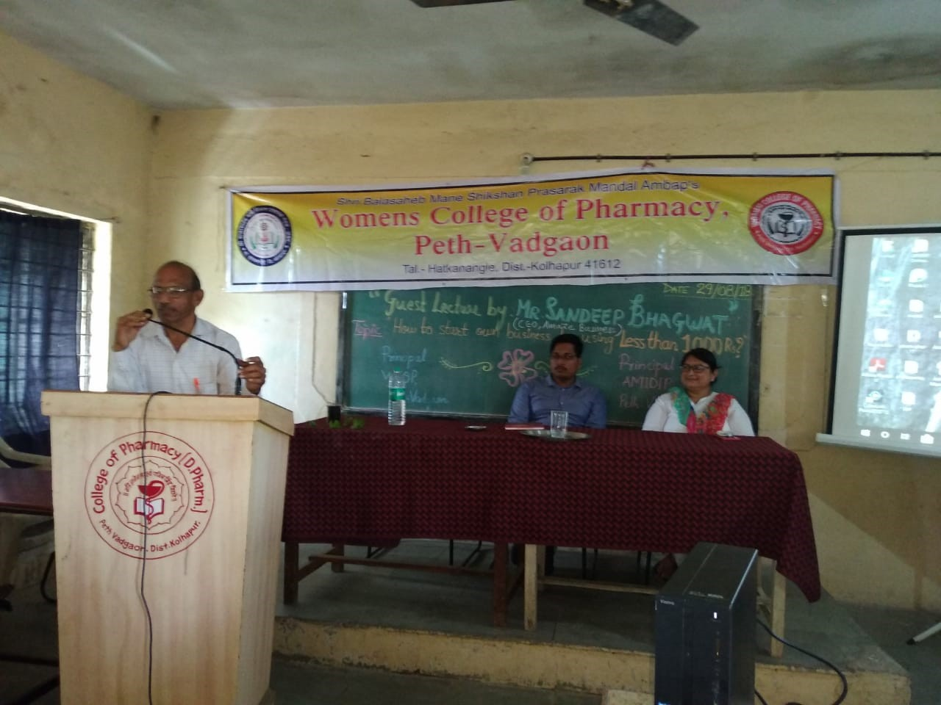

Slide 43
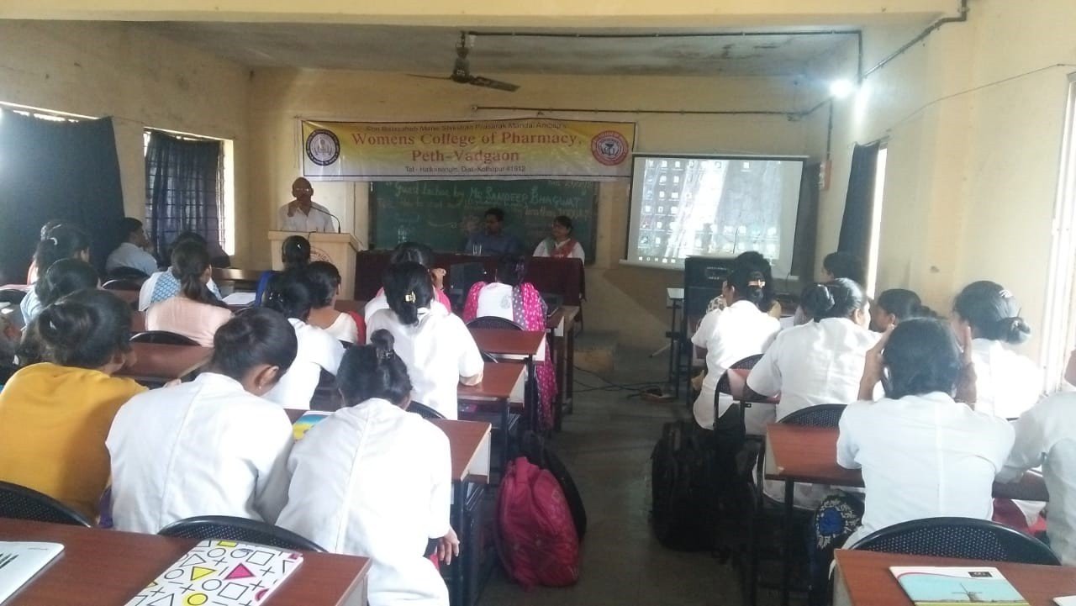

Slide 44
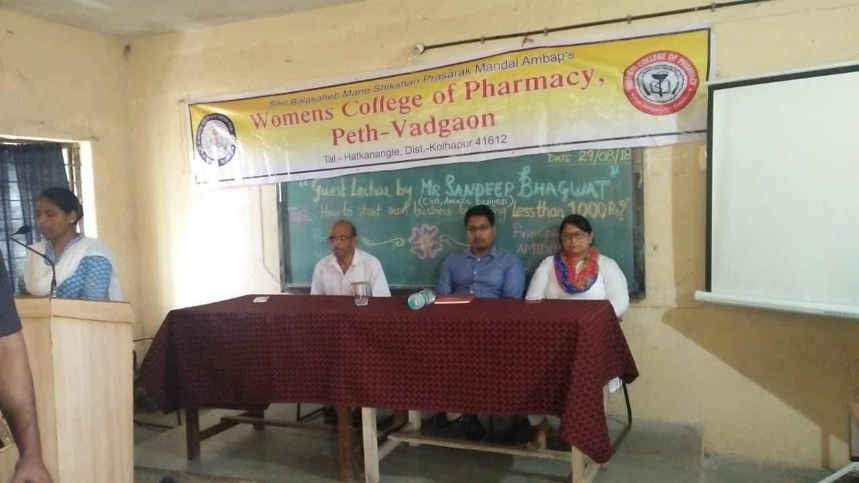

Slide 45
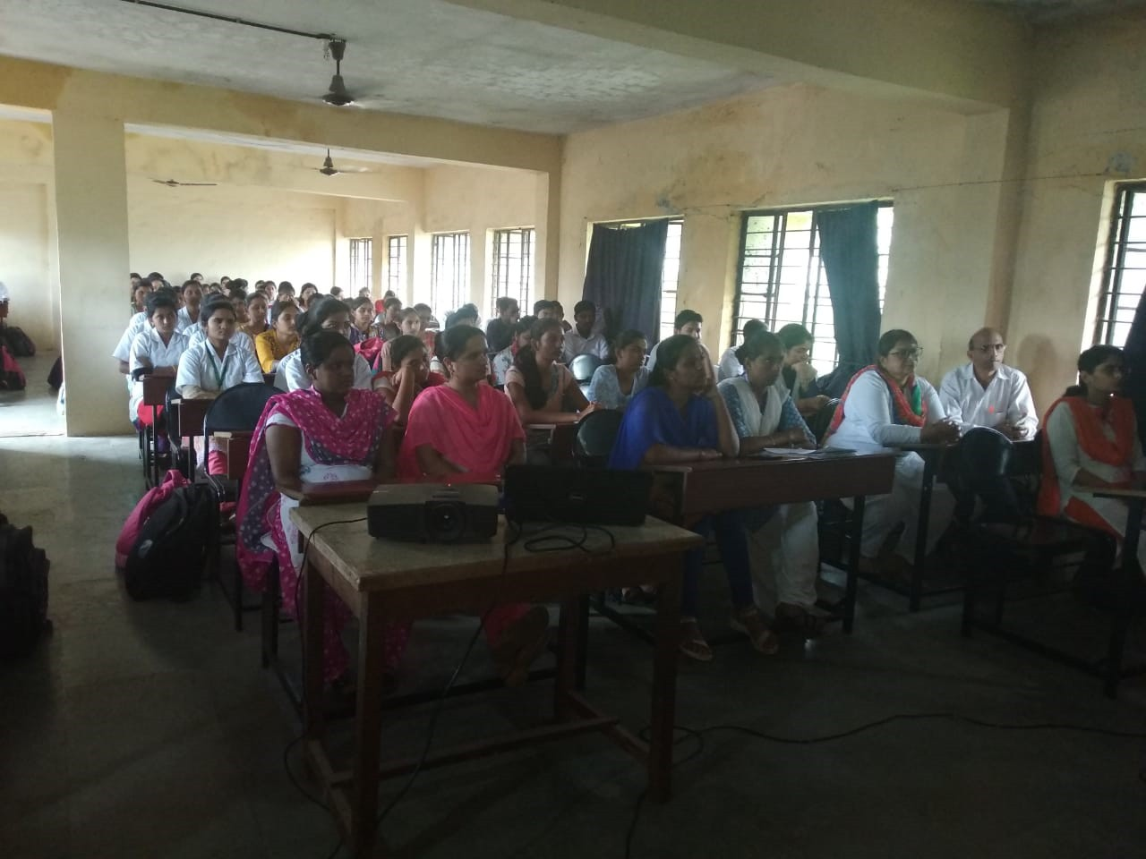

Slide 46
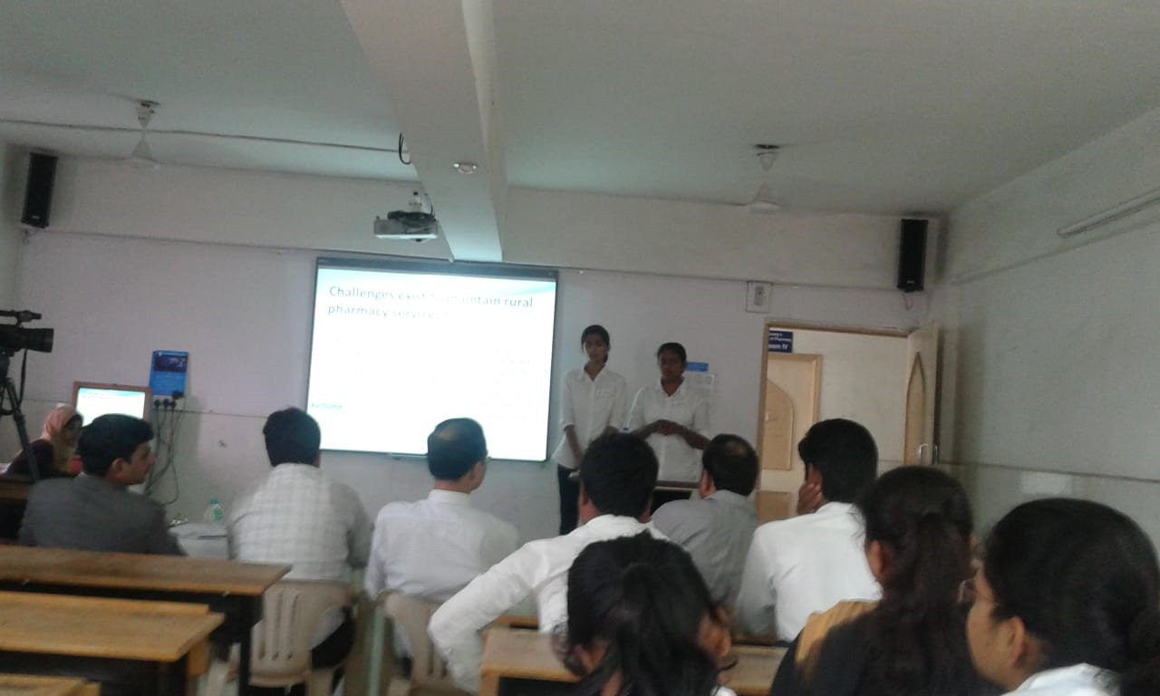
MSBTE Sponsored Organized at MCE Society Institute of Pharmacy, Azam Campus,Pune. On Date: 03/09/2018

Slide 47
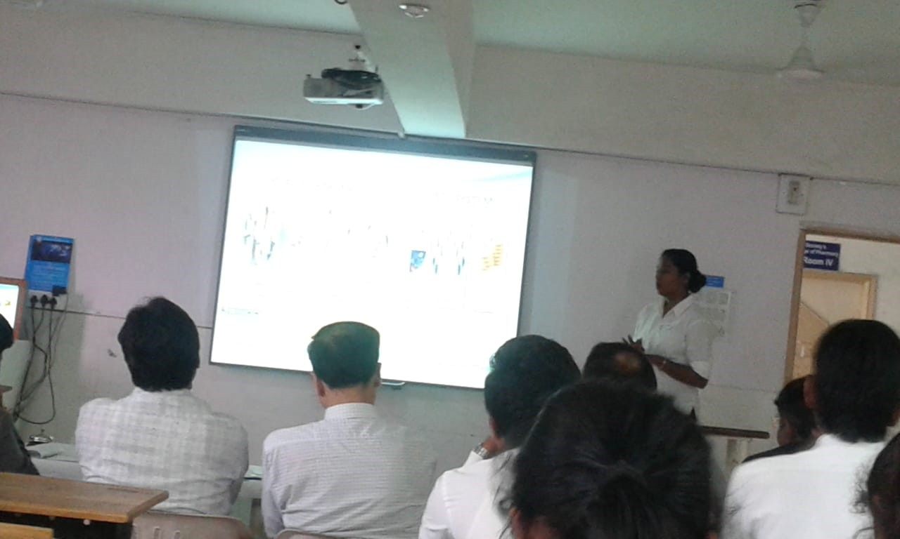

Slide 48
Grievance Cell

Slide 49


Slide 50


Slide 51


Slide 52


Slide 53

One Week Faculty Development Programme
In J. T.Mhajan College Faizpur Jalgaon On Date: 17/09/2018 -21/09/2018

Slide 54


Slide 55

Organized Quiz Competition On Occasion of World Pharmacist Day
On Date: 24/09/2018

Slide 56


Slide 57

Celebration of
World Pharmacist Day On Date: 25/09/2018

Slide 58


Slide 59

Drama

Slide 60


Slide 61

Poster Presentation Competition at Mhagaon On Date: 29/09/2018

Slide 62


Slide 63


Slide 64


Slide 65

Celebration of Surgical Strike Day
On Date: 29/09/2018

Slide 66


Slide 67


Slide 68


Slide 69

Parents-Teachers Meet
On Date: 02/10/2018

Slide 70
Vision of Womens Family
1.Seven Days Computer Literacy Course
2.Basic Fitness Course
3.Certified Yoga and Diet Course
4.Business Related Workshops in Collaboration with NYEDC.

Slide 71
Thank you

